Slide 1
Gym Tracker Web Application
Student Name: Oskar Grzenda
Supervisor Name: Joe Corr

Slide 2
Context & Objectives
Context
A web application that will allow users to track their gym progress in an easy and visual way
Key Objectives
Enhance my web development skills
Learn more about React
Showcase at interviews
Using a MERN stack to develop a web application

Slide 3

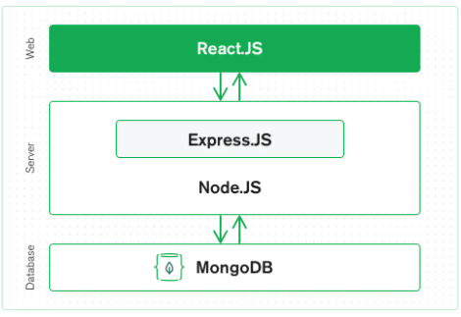
Technologies & System Architecture
MERN stack
Mongo DB: Backend database
Express JS: Framework for Node.js
React: front-end JS library for UI components
Node JS: back-end JS run time environment which runs JS codes

Slide 4
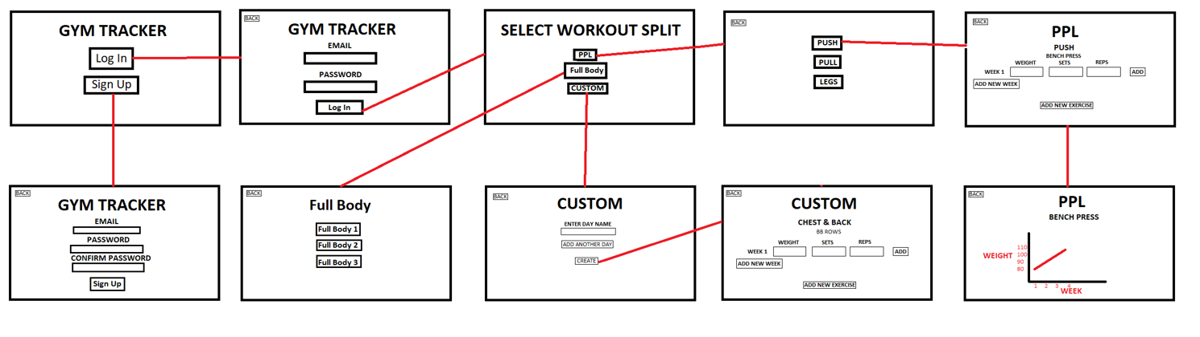
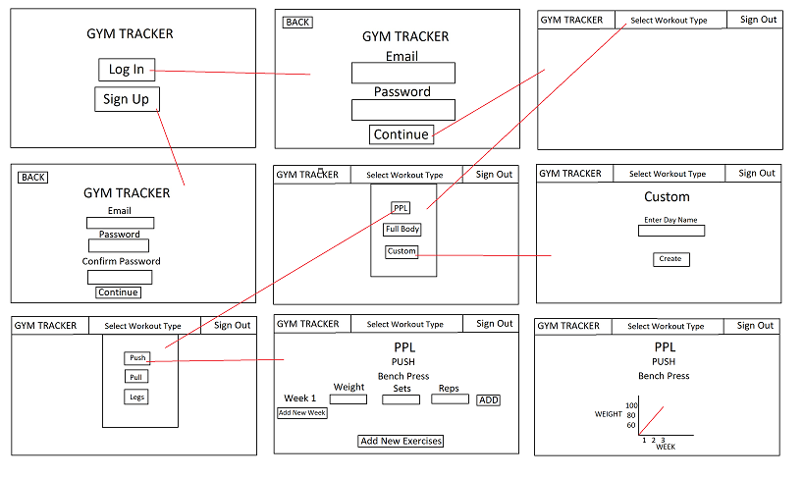
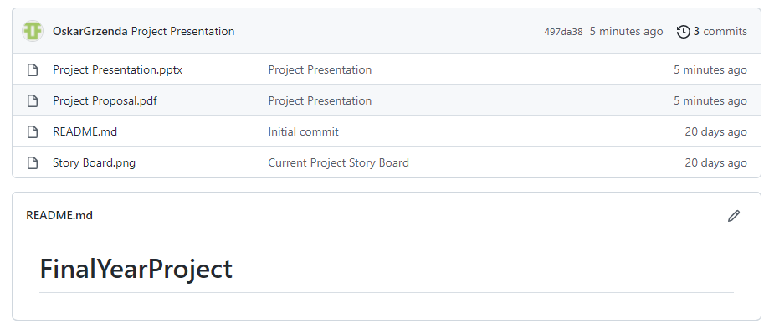
Development & Deployment
Wireframe
Github repository
Project Dissertation

Slide 5
Work Plan
Show a Gantt Chart of the set of remaining activities.
Don’t forget to include your dissertation document and any other deliverables.

